Slide 1
Gender economy
CAPSTONE PROJECT
Presented By:
Kaushik G
9513- Jayaraj Annapackiam CSI College OF Engineering
B.E Mechanical Engineering

Slide 2
OUTLINE
Problem Statement
Proposed System/Solution
System Development Approach
Algorithm & Deployment
Result
Conclusion
Future Scope
References

Slide 3
Problem Statement
In modern economies, gender disparities persist across various sectors, ranging from employment opportunities and income levels to access to education and leadership roles. Despite progress in some areas, significant challenges remain in achieving gender equality and promoting economic empowerment for all genders. This calls for a deeper understanding of the structural, cultural, and policy-related factors that contribute to these disparities and the development of targeted strategies to address them effectively. The goal is to create inclusive and equitable economies where everyone, regardless of gender, has equal opportunities to thrive and contribute to sustainable economic growth.

Slide 4
Proposed Solution
One proposed solution to address gender disparities in the economy involves implementing a combination of policies and initiatives at various levels:
Equal Pay Policies: Enforce and strengthen laws and regulations that mandate equal pay for equal work, ensuring that women and men receive the same compensation for similar roles.
Promoting Women's Entrepreneurship: Provide support and resources for women entrepreneurs, including access to financing, mentorship programs, and networking opportunities. Encourage the development of women-led businesses to boost economic participation and innovation.
Flexible Work Arrangements: Promote flexible work policies such as telecommuting, flexible hours, and parental leave to accommodate diverse family responsibilities and promote work-life balance for all genders.
Investing in Education: Ensure equal access to quality education and training programs for girls and women, especially in fields traditionally dominated by men. Encourage STEM (Science, Technology, Engineering, and Mathematics) education for girls to bridge the gender gap in these high-demand sectors.
Addressing Unconscious Bias: Implement training programs and awareness campaigns to address unconscious bias in recruitment, promotion, and performance evaluations. Encourage organizations to adopt fair and transparent hiring and promotion practices.
Supporting Caregivers: Provide affordable and accessible childcare services, eldercare support, and paid family leave policies to reduce the burden of caregiving responsibilities, particularly on women, and enable greater workforce participation.

Slide 5
System Approach
A systemic approach to addressing gender disparities in the economy involves considering the interconnectedness of various factors and designing holistic strategies that target root causes. Here's how such an approach could be structured:
Understanding System Dynamics:
Identify and analyze the complex interrelationships between economic systems, social norms, cultural attitudes, and policy frameworks that contribute to gender inequalities.
Use systems thinking tools such as causal loop diagrams and feedback loops to map out how different factors influence each other and perpetuate gender disparities.
Policy Coherence:
Ensure coherence and alignment across policies related to education, labor market participation, healthcare, social protection, and entrepreneurship to address gender inequalities comprehensively.
Integrate gender perspectives into policy design, implementation, and evaluation processes to promote synergies and avoid unintended consequences.
Multi-Stakeholder Collaboration:
Foster collaboration among governments, businesses, academia, civil society organizations, and international institutions to leverage diverse expertise, resources, and networks.
Establish platforms for dialogue, knowledge sharing, and joint action to develop shared goals and coordinated strategies for advancing gender equality in the economy.
Data-Driven Decision Making:
Improve data collection, disaggregation, and analysis to generate evidence-based insights into gender gaps, trends, and disparities across economic sectors and demographics.

Slide 6
Algorithm & Deployment
Designing an algorithm for addressing gender disparities in the economy involves several steps, including data collection, analysis, modeling, and deployment. Here's a high-level overview of how such an algorithm could be developed and deployed:
Data Collection and Preprocessing:
Gather relevant data from various sources, including demographic data, labor market statistics, educational attainment, income levels, employment rates, and gender-specific indicators.
Clean and preprocess the data to handle missing values, outliers, and inconsistencies. Ensure data privacy and ethical considerations are adhered to throughout the process.
Algorithm Selection and Training:
Choose appropriate machine learning algorithms or statistical models based on the nature of the problem and the available data. Common algorithms for gender economics analysis may include regression models, classification algorithms, clustering techniques, and causal inference methods.
Split the data into training and testing sets for model training and evaluation. Fine-tune hyperparameters and optimize the model's performance using techniques like cross-validation and grid search.
Deployment and Integration:
Deploy the trained algorithm into a production environment, such as a web application, API service, or decision support system, where it can be accessed and utilized by policymakers, researchers, and stakeholders.
Integrate the algorithm with existing data systems, dashboards, and policy frameworks to facilitate real-time monitoring, policy simulations, and decision-making based on gender economics insights.

Slide 7
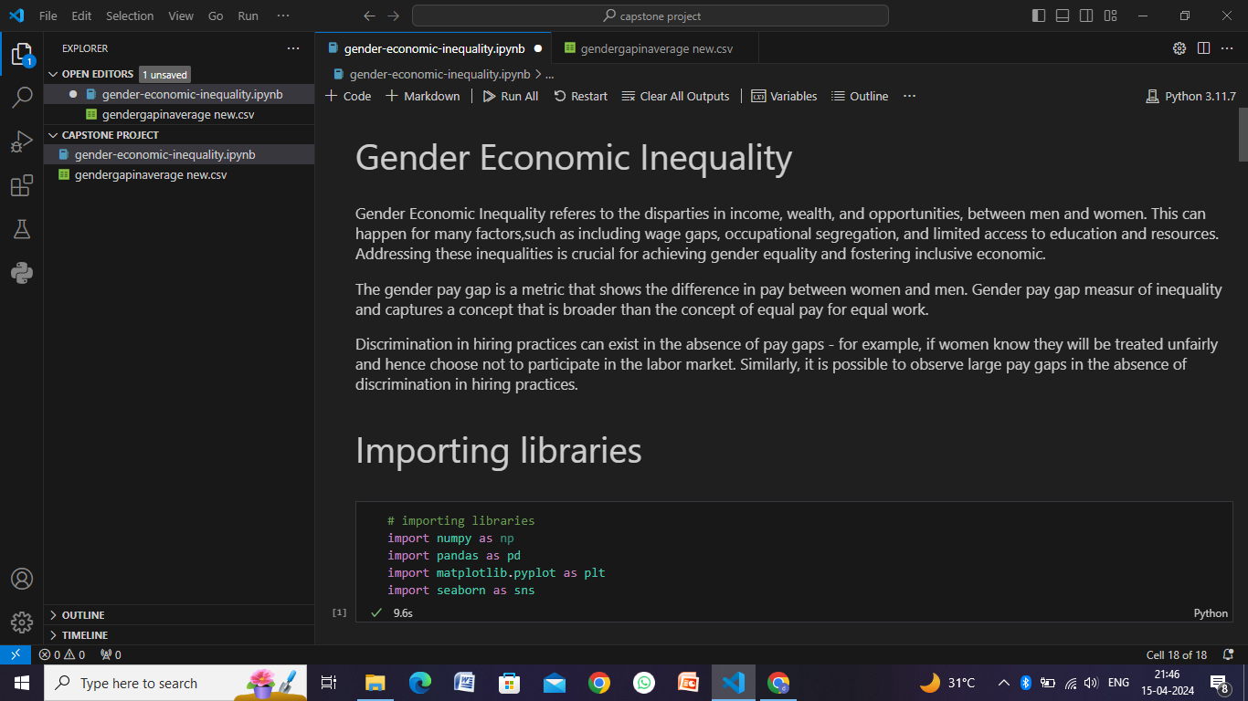
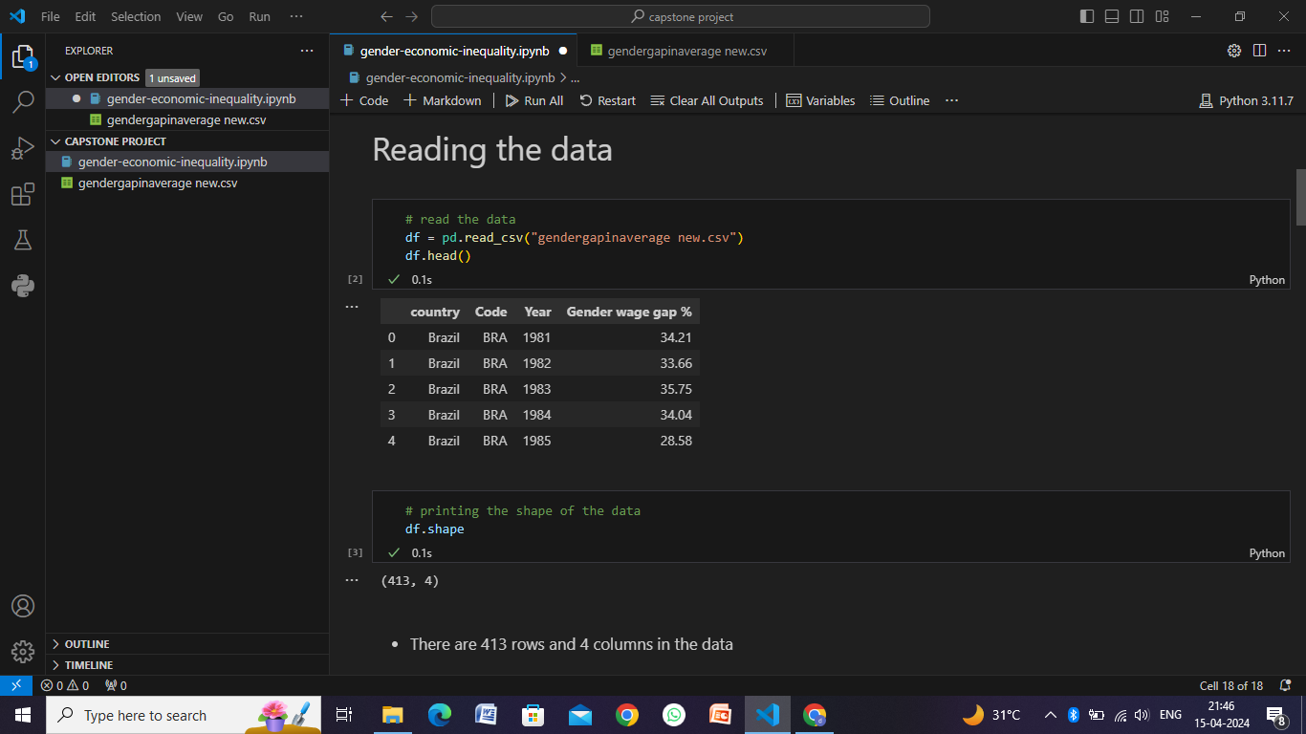
Result

Slide 8
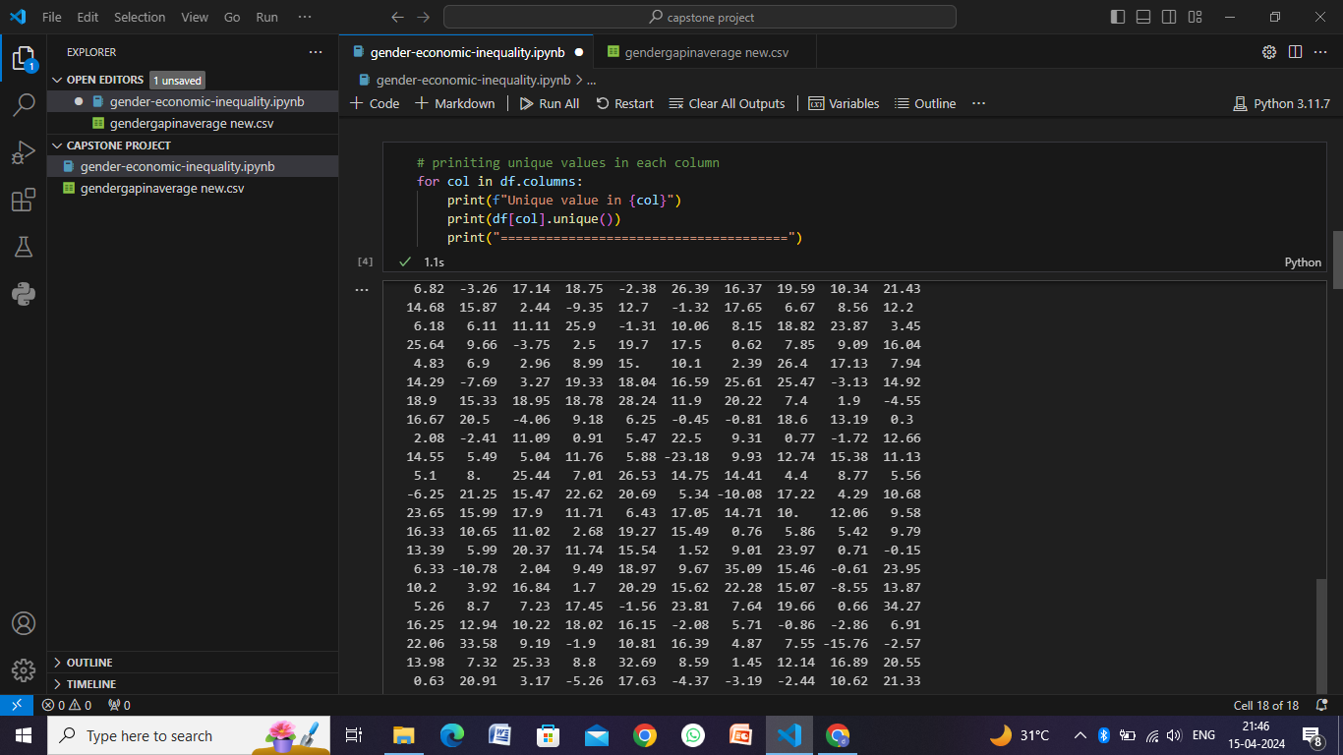
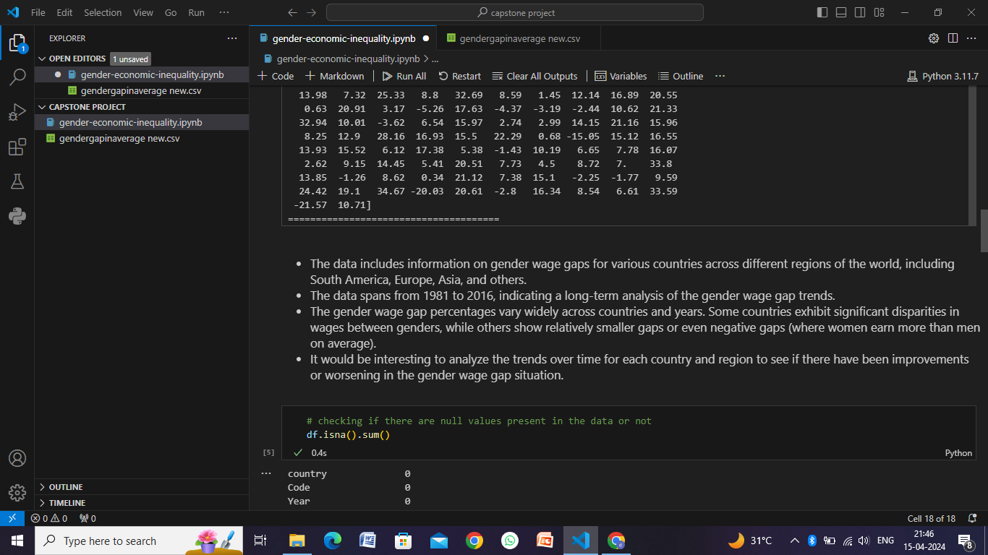
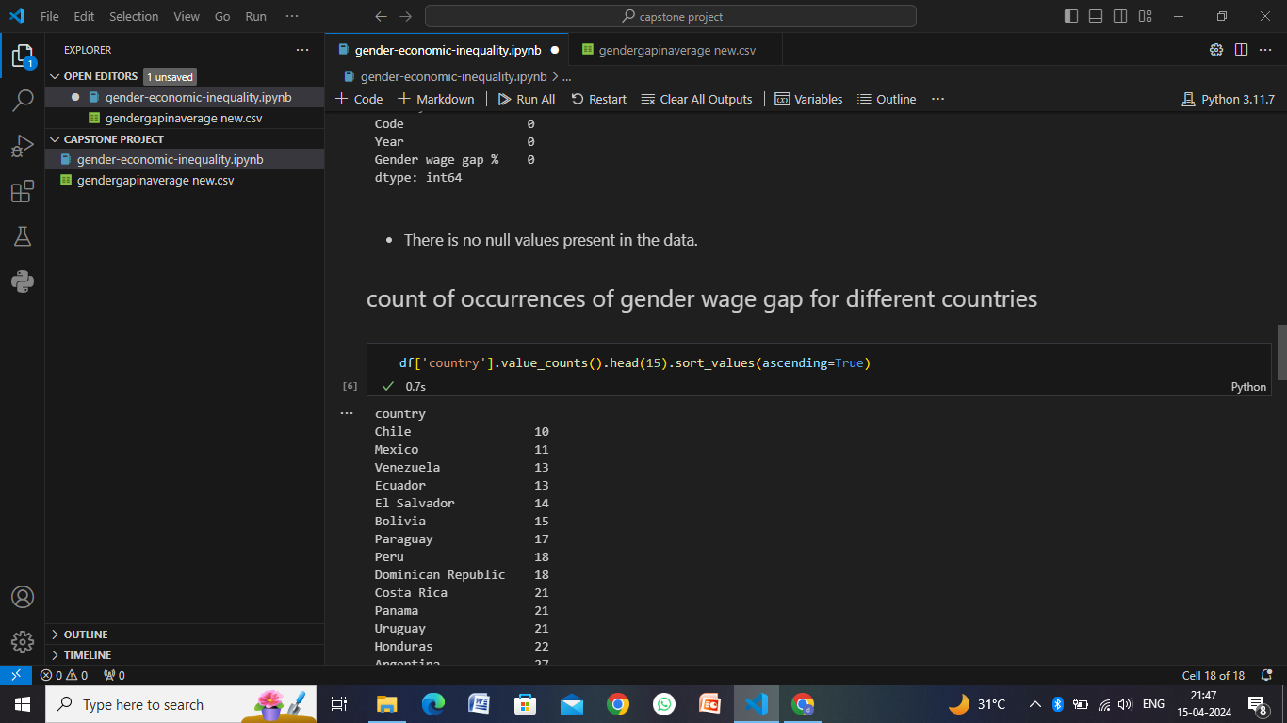
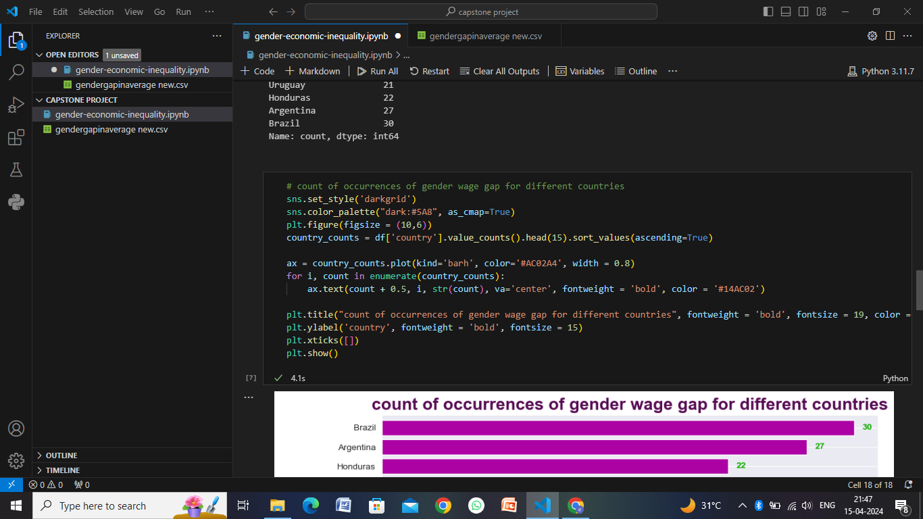

Slide 9
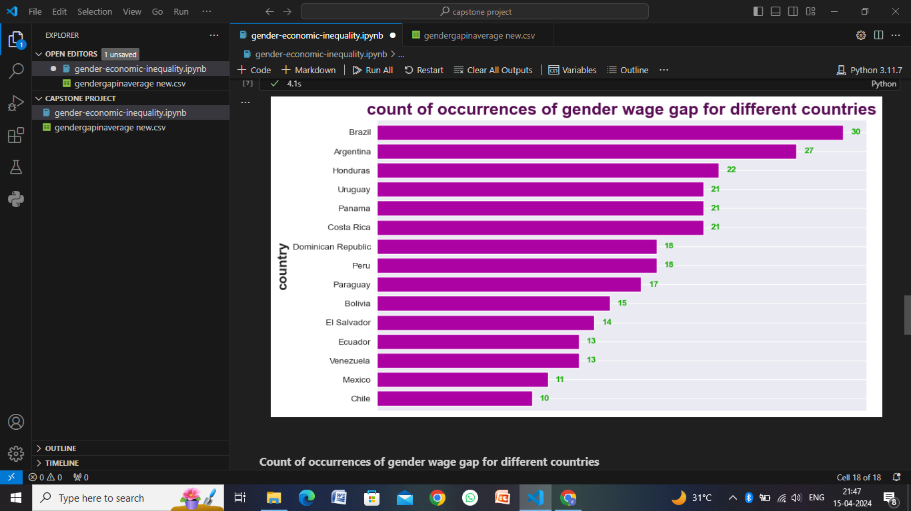
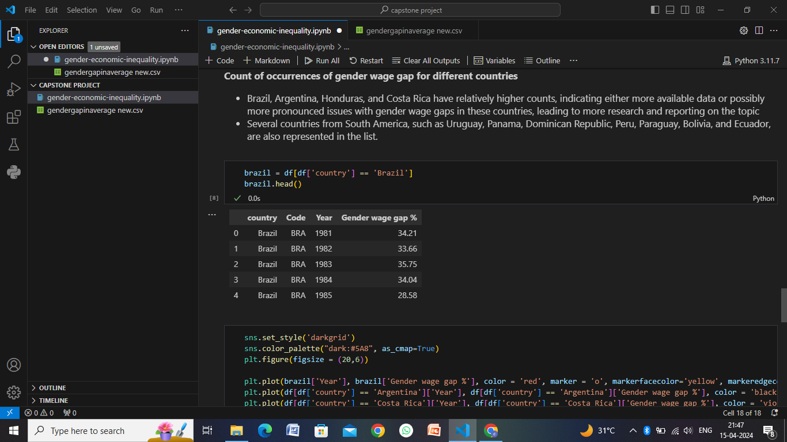
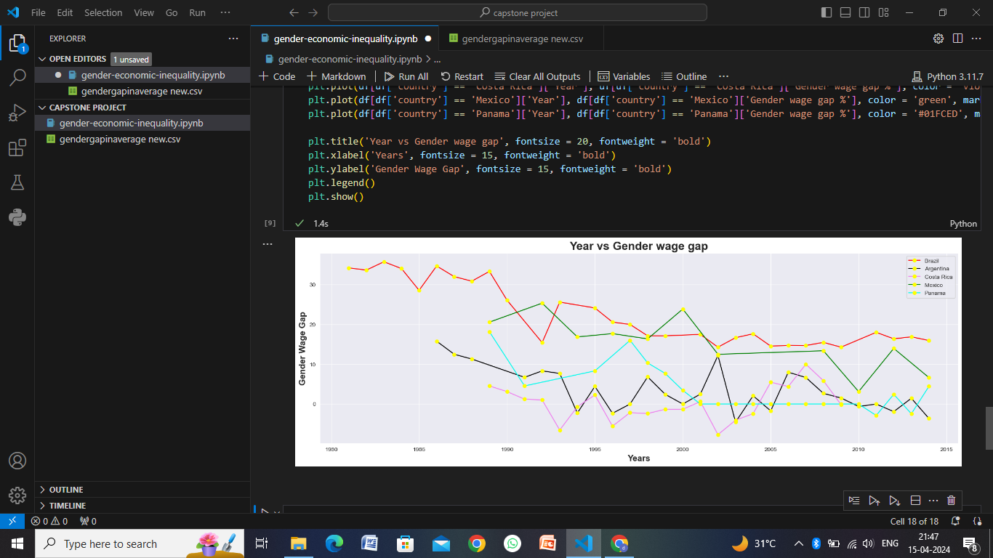
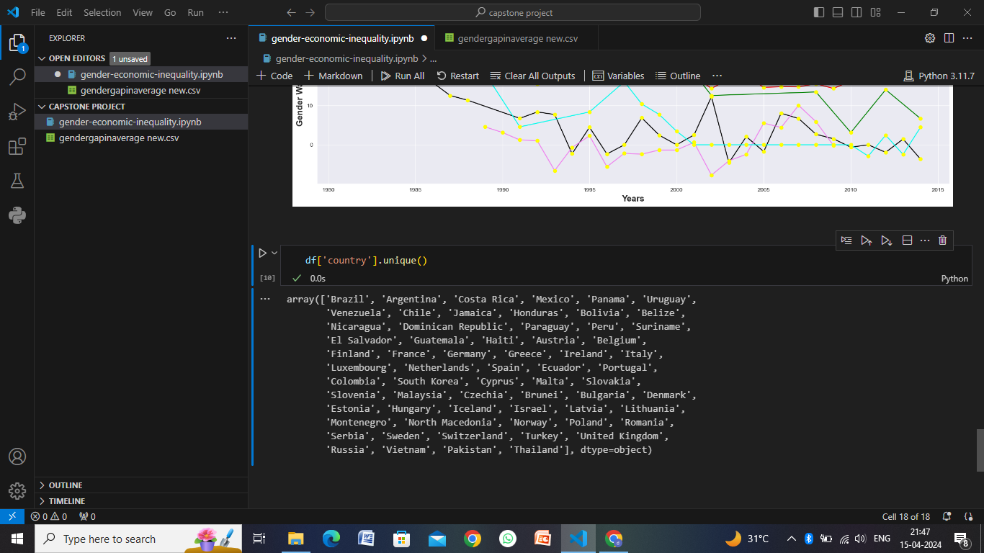

Slide 10
Conclusion
In conclusion, addressing gender disparities in the economy requires a multifaceted approach that encompasses policy interventions, societal changes, and systemic transformations. It's imperative to recognize that achieving gender equality is not just a moral imperative but also an economic imperative, as it unlocks the full potential of individuals and contributes to sustainable economic growth and development. Here are key points to consider:
Economic Benefits of Gender Equality
Policy Frameworks for Gender Equality
Cultural and Social Norms
Inter sectionality
Data-Driven Decision Making
Collaborative Efforts:
Long-Term Commitment

Slide 11
Future scope
The future scope of gender economics is wide-ranging and holds significant potential for transformative change in various domains. Here are some key areas of focus and potential developments:
Technology and Innovation
Future of Work
Green Economy and Sustainability
Financial Inclusion and Economic Empowerment
Health and Well-being
Policy Innovation
Global Collaboration
Research and Education

Slide 12
References
Academic Journals:
"Feminist Economics" (journal published by the International Association for Feminist Economics)
"Journal of Gender and Economics" (published by the Japanese Association for Gender and Economics)
"Review of Economics of the Household" (covers topics related to family, gender, and household economics)
"World Development" (includes research on gender, development, and economics)
Websites and Organizations:
United Nations Women (unwomen.org) - Provides data, reports, and resources on gender equality and women's empowerment in the economy.
International Labour Organization (ilo.org) - Publishes reports and resources on gender equality in the labor market and workplace.
Catalyst (catalyst.org) - Focuses on promoting gender diversity and inclusion in corporate leadership and workplaces.
Policy Reports and Studies:
McKinsey Global Institute - "The Power of Parity: Advancing Women's Equality in the United States" (mckinsey.com/mgi) - Offers insights and recommendations for closing gender gaps in the economy.
OECD - "Gender Equality in Education, Employment, and Entrepreneurship" (oecd.org/gender) - Provides policy analysis and recommendations for advancing gender equality across multiple sectors.
International Monetary Fund (IMF) - "Women, Work, and the Economy: Macroeconomic Gains from Gender Equity" (imf.org) - Examines the economic benefits of gender equality and policy interventions.

Slide 13
THANK YOU

